Slide 1

INTRODUCTION TO DSA & ARRAYS
KEY TOPICS:
PRESENTER INFO:
DSA Basics
Problem-solving with data structures & algorithms
Real-world applications
Arrays
Fast access, slow inserts
Operations on Array
Types of Array
Fixed vs dynamic size
Problem Solving
Strings
Recursion
Rishav Kumar
B.Tech. AI&DS
Gati Shakti Vishwavidyalaya
https://www.linkedin.com/in/rishav-kumar-2399241ab/
1
TECHOCRATS PROGRAMMING DOMAIN DSA SERIES DATE OF PRESENTATION: 24/06/2025

Slide 2
REFERENCES:
Dr. Shweta Saharan Ma’am DSA PPT (Assistant Professor GSV)
Geeks for Geeks
Visual Algo
Data Structures using C (Reema Thareja)
2
TECHOCRATS PROGRAMMING DOMAIN DSA SERIES DATE OF PRESENTATION: 24/06/2025

Slide 3
INTRODUCTION
Data structures are the backbone of efficient algorithm design and real-world software development.
A data structure is an arrangement of data either in computer's memory or on the disk storage.
• Some common examples of data structures are arrays, linked lists, queues, stacks, binary trees, graphs, and hash tables.
• Data structures are widely applied in areas like:
Compiler design
Operating system
Statistical analysis package
DBMS
Numerical analysis
Simulation
3
TECHOCRATS PROGRAMMING DOMAIN DSA SERIES DATE OF PRESENTATION: 24/06/2025

Slide 4
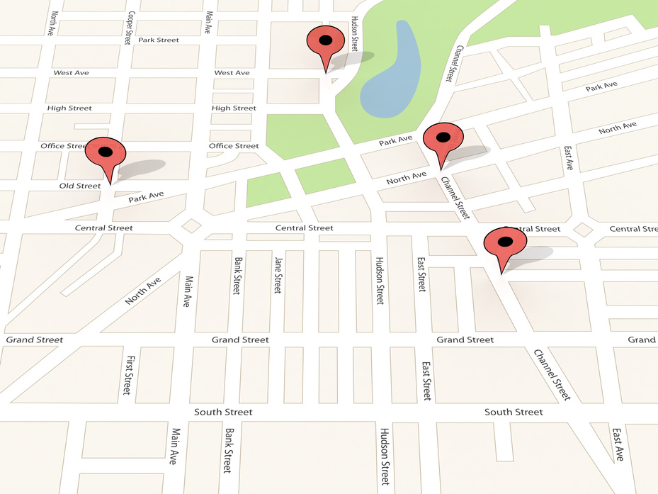


DSA IN REAL-WORLD
DSA Used: Graphs
DSA Used: Graphs (users as nodes, friendships as edges), BFS/DFS
How:
"People You May Know" uses BFS to find 2nd/3rd-degree connections.
Newsfeed ranking uses graph traversals + ML.
DSA Used: Matrices (user-movie ratings), Collaborative Filtering (k-nearest neighbors)
How: Converts user preferences into a matrix, then finds similar users via dimensionality reduction (SVD).
4
TECHOCRATS PROGRAMMING DOMAIN DSA SERIES DATE OF PRESENTATION: 24/06/2025

Slide 5
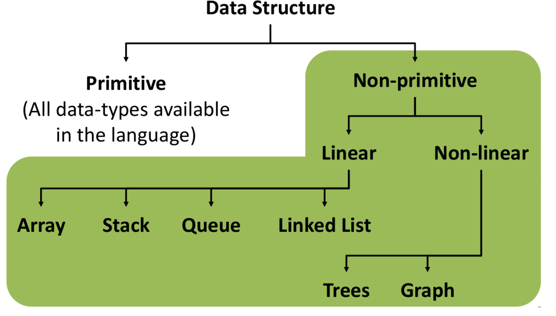
Classification Of DS:
Linear: Each element is connected to the one before and after (except the first and last).
Non-Linear: In non-linear data structures, elements are arranged in a hierarchical or multi-level manner.
One element can be connected to multiple others.
5
TECHOCRATS PROGRAMMING DOMAIN DSA SERIES DATE OF PRESENTATION: 24/06/2025

Slide 6
THE PROBLEM-SOLVING
PROCESS IN PROGRAMMING ?
6
TECHOCRATS PROGRAMMING DOMAIN DSA SERIES DATE OF PRESENTATION: 24/06/2025

Slide 7

THE PROBLEM-SOLVING
PROCESS IN PROGRAMMING ?
1.
UNDERSTANDING
THE PROBLEM.
2.
DESIGNING AN ALGORITHM.
3.
CHOOSING APPROPRIATE
DATA STRUCTURES.
4.
IMPLEMENTING
THE SOLUTION.
5.
TESTING
AND OPTIMIZING
7
TECHOCRATS PROGRAMMING DOMAIN DSA SERIES DATE OF PRESENTATION: 24/06/2025

Slide 8

KEY INSIGHT – THINK BEYOND CODE
Algorithms and Data Structures are Language-Agnostic
They define logic and structure, not syntax.
The same algorithm can be implemented in any programming language.
Why it Matters:
Mastering the process makes you a better problem solver across any language or platform.
8
TECHOCRATS PROGRAMMING DOMAIN DSA SERIES DATE OF PRESENTATION: 24/06/2025

Slide 9
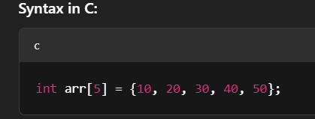
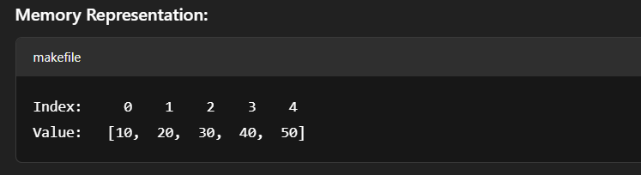
ARRAYS:
What is an Array?
An array is a collection of elements of the same data type stored at contiguous memory locations.
You can access each element using an index (starting from 0).
Element: A single value in the array
Index: Position number (starts from 0)
Length: Total number of elements
9
TECHOCRATS PROGRAMMING DOMAIN DSA SERIES DATE OF PRESENTATION: 24/06/2025

Slide 10
BASIC ARRAY OPERATION:
Traversal
Insertion
Deletion
Accessing
int arr[5] = {1,2,3,4,5}
arr[0] = 1
arr[1] = 2
arr[2] = 3
arr[3] = 4
arr[4] = 5
10
TECHOCRATS PROGRAMMING DOMAIN DSA SERIES DATE OF PRESENTATION: 24/06/2025

Slide 11
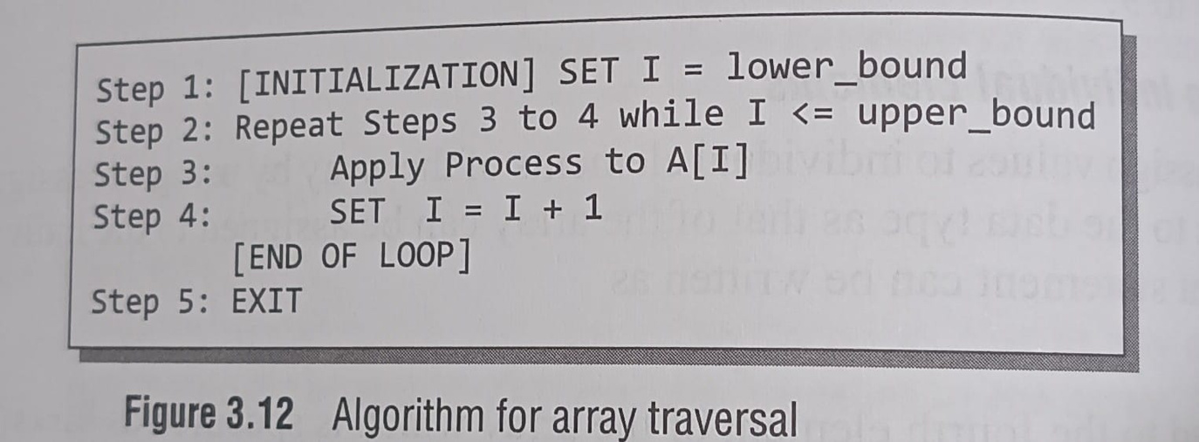
BASIC ARRAY OPERATION:
Traversal:
11
TECHOCRATS PROGRAMMING DOMAIN DSA SERIES DATE OF PRESENTATION: 24/06/2025

Slide 12
BASIC ARRAY OPERATION:
Traversal Example Problems:
Write a program to read and display n numbers using array.
Write a Program to find the mean of n numbers using arrays
Write a program to find the second largest of n numbers using an array.
Write a Program to find weather the array of integers contains a duplicate number.
12
TECHOCRATS PROGRAMMING DOMAIN DSA SERIES DATE OF PRESENTATION: 24/06/2025

Slide 13
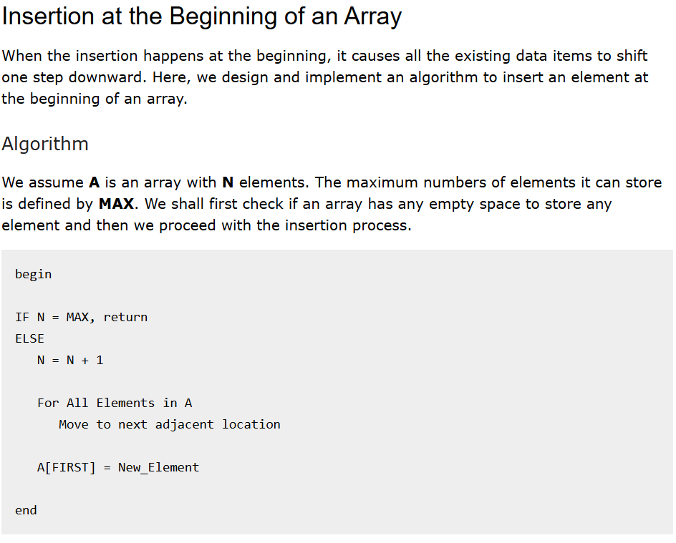
BASIC ARRAY OPERATION:
13
TECHOCRATS PROGRAMMING DOMAIN DSA SERIES DATE OF PRESENTATION: 24/06/2025

Slide 14
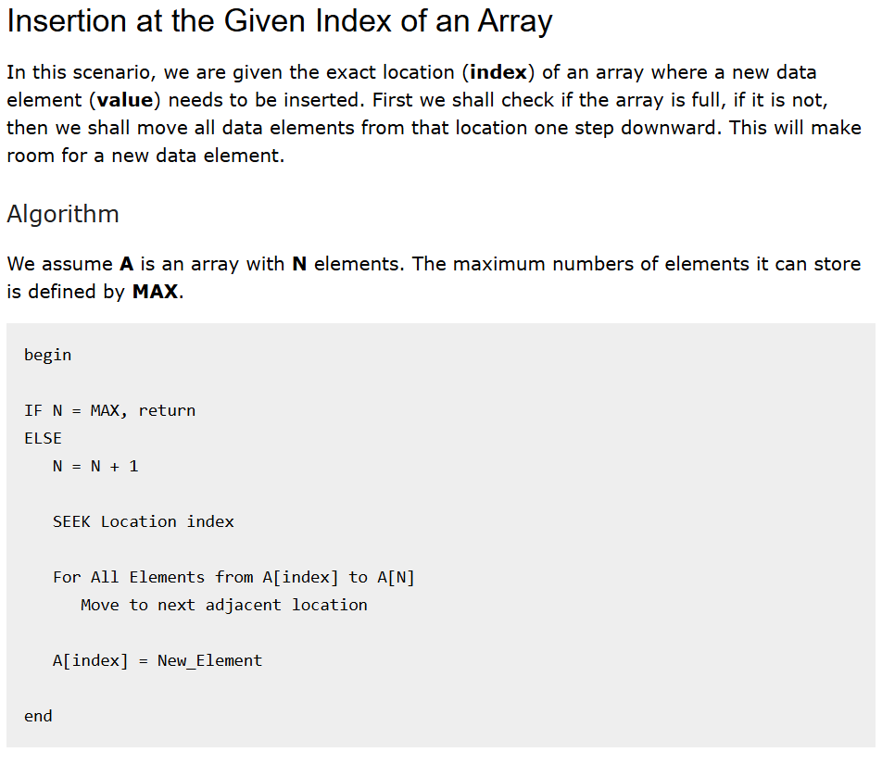
BASIC ARRAY OPERATION:
14
TECHOCRATS PROGRAMMING DOMAIN DSA SERIES DATE OF PRESENTATION: 24/06/2025

Slide 15
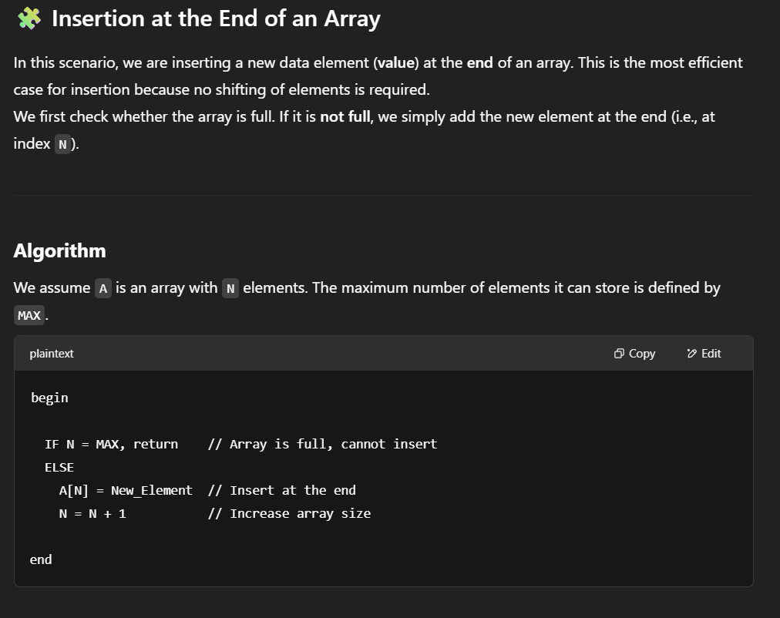
BASIC ARRAY OPERATION:
15
TECHOCRATS PROGRAMMING DOMAIN DSA SERIES DATE OF PRESENTATION: 24/06/2025

Slide 16
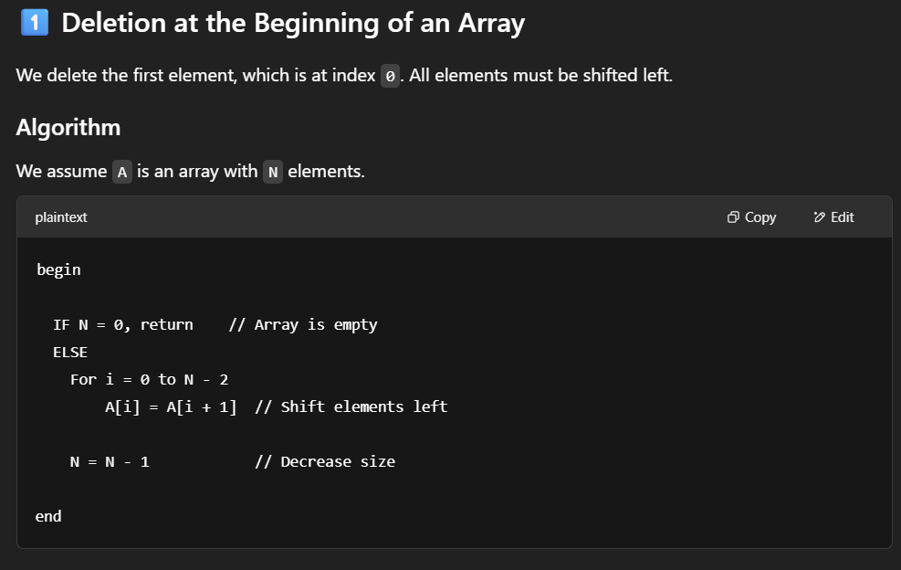
BASIC ARRAY OPERATION:
16
TECHOCRATS PROGRAMMING DOMAIN DSA SERIES DATE OF PRESENTATION: 24/06/2025

Slide 17
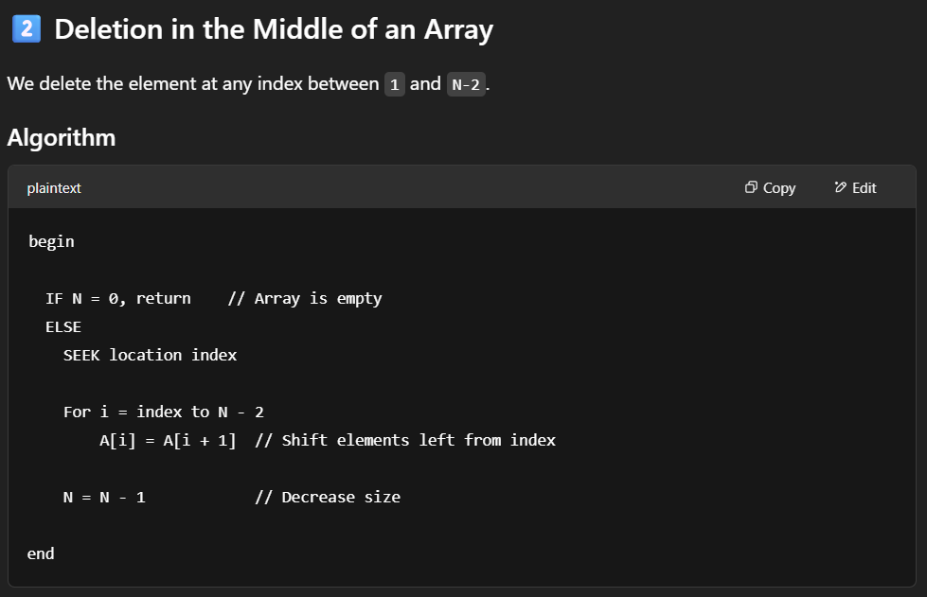
BASIC ARRAY OPERATION:
17
TECHOCRATS PROGRAMMING DOMAIN DSA SERIES DATE OF PRESENTATION: 24/06/2025

Slide 18
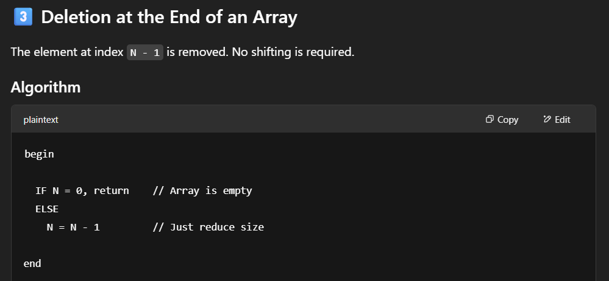
BASIC ARRAY OPERATION:
18
TECHOCRATS PROGRAMMING DOMAIN DSA SERIES DATE OF PRESENTATION: 24/06/2025

Slide 19
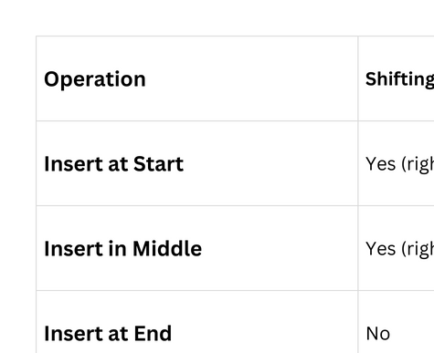
BASIC ARRAY OPERATION:
19
TECHOCRATS PROGRAMMING DOMAIN DSA SERIES DATE OF PRESENTATION: 24/06/2025

Slide 20
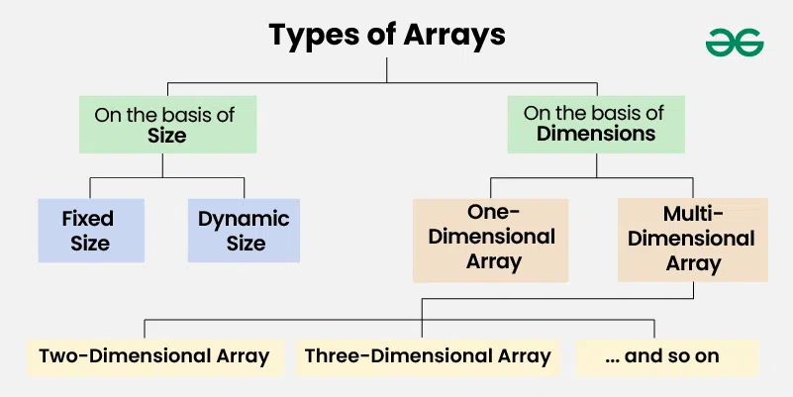
Types of Array:
https://www.geeksforgeeks.org/types-of-arrays/
20
TECHOCRATS PROGRAMMING DOMAIN DSA SERIES DATE OF PRESENTATION: 24/06/2025

Slide 21
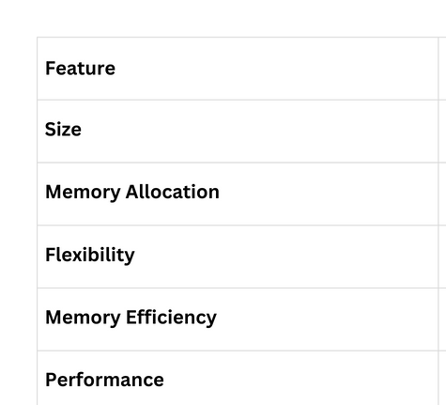
Static & Dynamic Array:
21
TECHOCRATS PROGRAMMING DOMAIN DSA SERIES DATE OF PRESENTATION: 24/06/2025

Slide 22
Let’s Solve some Problems: ...
Finding the maximum/minimum element in an array.
Reversing an array.
Checking if an element exists in an array.
22
TECHOCRATS PROGRAMMING DOMAIN DSA SERIES DATE OF PRESENTATION: 24/06/2025

Slide 23
What is a String in C?
A string in C is a 1D array of characters ending with a '\0' (null character).
Example: char str[] = "Hello";
Stored in contiguous memory.
C doesn't have a built-in string data type like other high-level languages.
H
E
L
L
O
\0
23
TECHOCRATS PROGRAMMING DOMAIN DSA SERIES DATE OF PRESENTATION: 24/06/2025

Slide 24
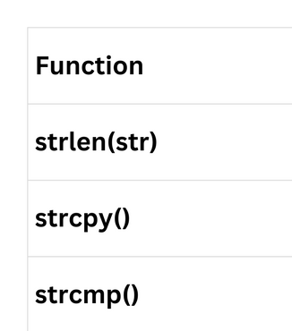
Core String Functions in C
24
TECHOCRATS PROGRAMMING DOMAIN DSA SERIES DATE OF PRESENTATION: 24/06/2025

Slide 25

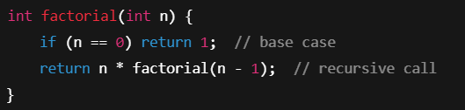
What is Recursion?
Recursion is when a function calls itself to solve smaller instances of a problem.
Must have:
Base case – stops recursion
Recursive case – reduces the problem
Basic Syntax:
Each recursive call adds a new frame to the call stack.
Stack grows until base case is reached.
25
TECHOCRATS PROGRAMMING DOMAIN DSA SERIES DATE OF PRESENTATION: 24/06/2025

Slide 26
Thankyou :-)
Feedback
26

